Slide 1
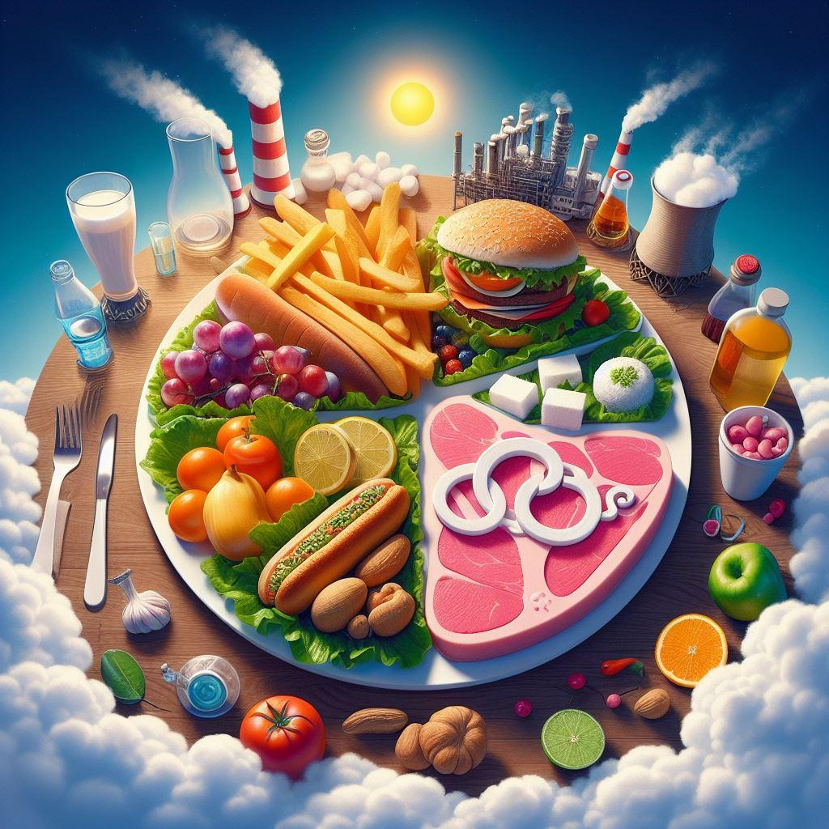

Project Tableau v.2 Food
DATA VISUALIZATION
Mirko Rossi

Slide 2

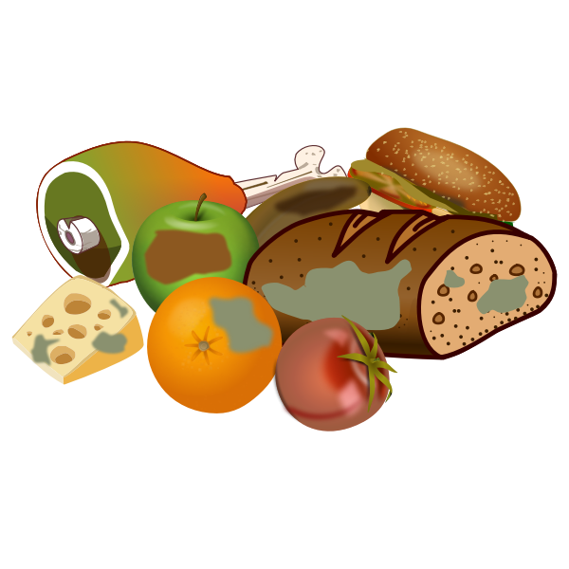
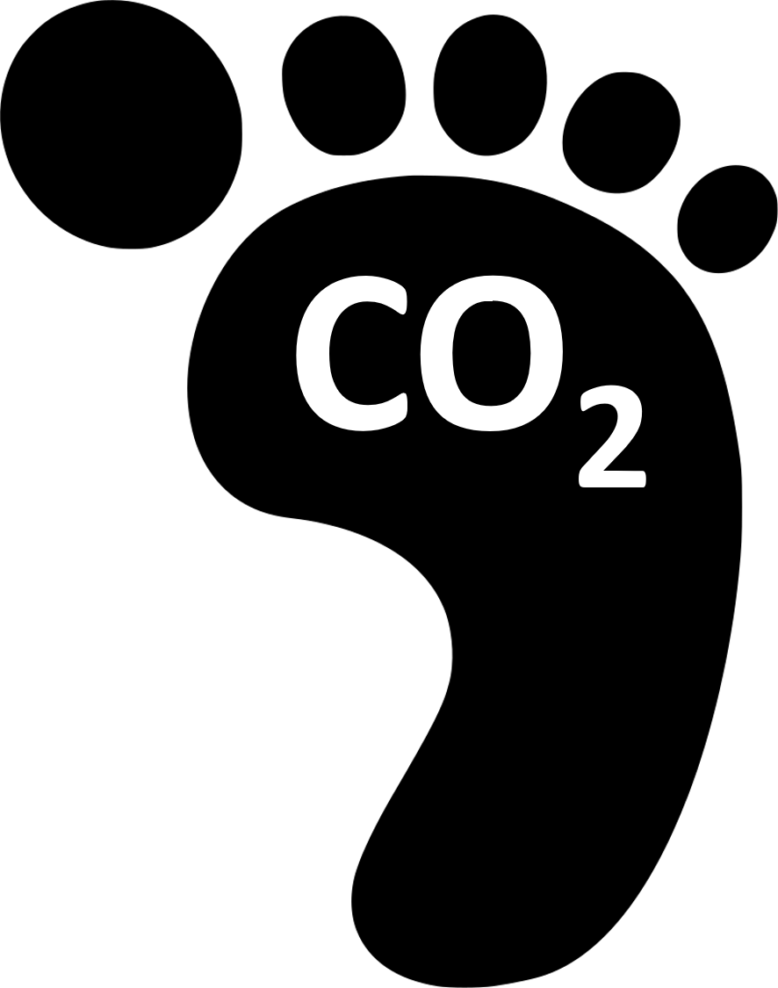
Introduction
Nowadays, attention towards dietary styles is not only a question of well-being but also of environmental sustainability.
Poore and Nemeck's scientific work measures the ecological footprint of a vast list of foods.
I analyzed the related dataset using Tableau Data Visualization software.
This project is available for free consultation on Tableau Public.

Slide 3
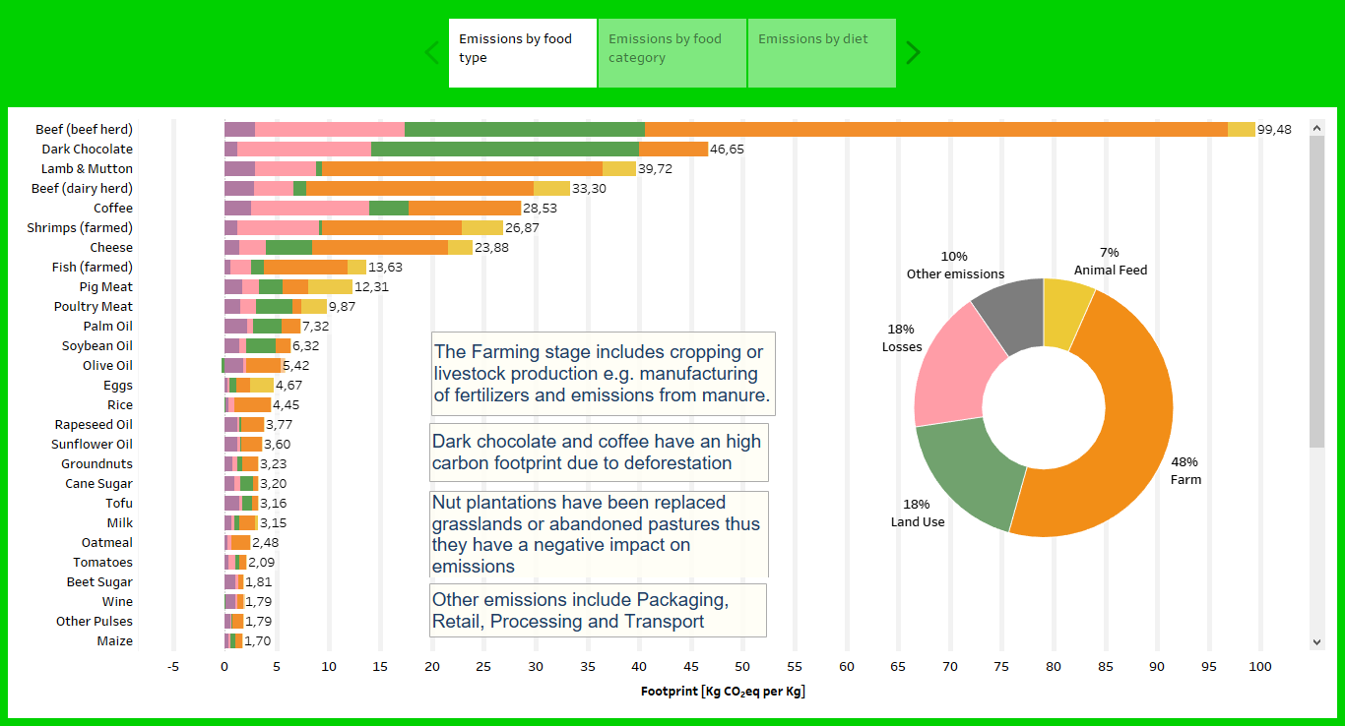

Slide 4
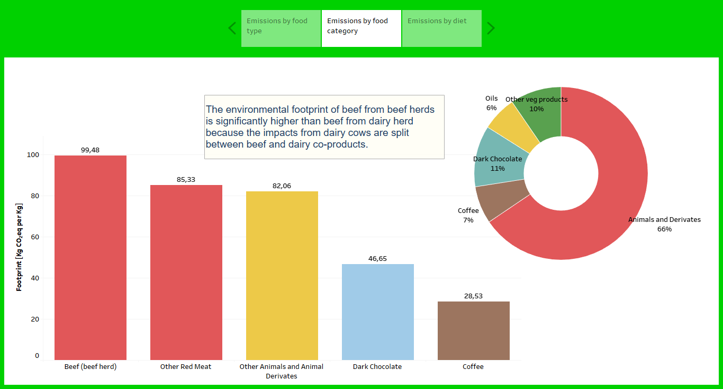

Slide 5
